Slide 1
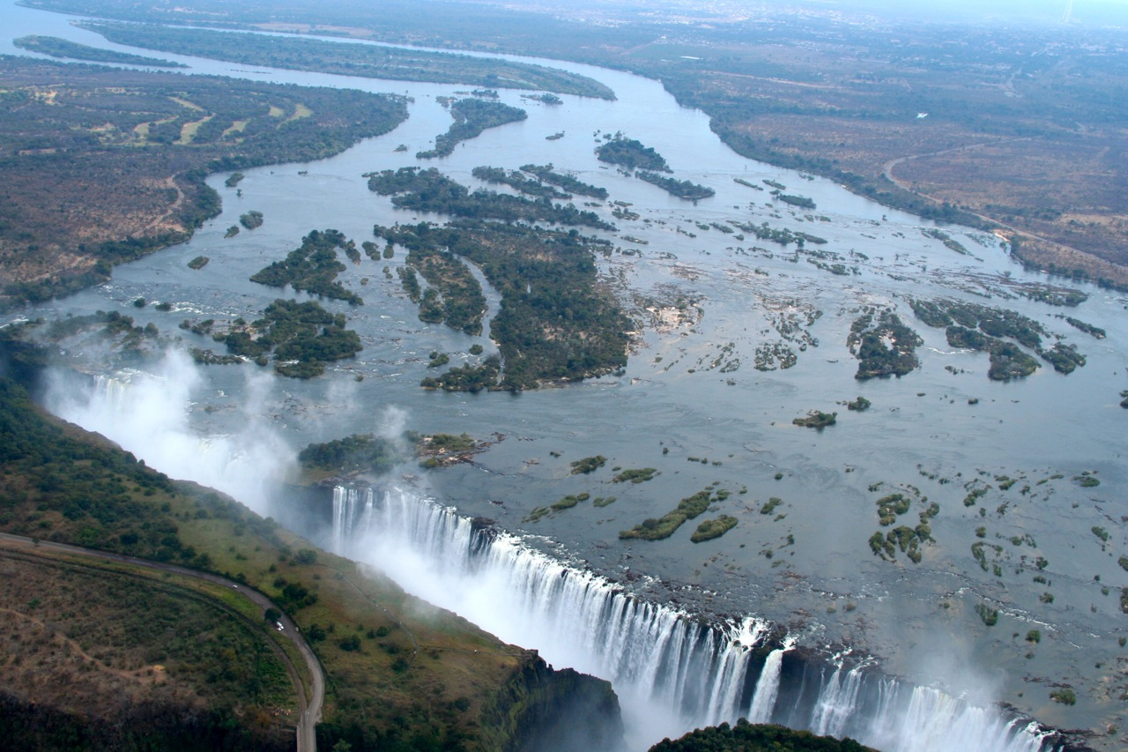


Zambia Development Agency
ZAMBIA
LAND OF BOUNDLESS
INVESTMENT OPPORTUNITIES
ZAMBIA – 2017

Slide 2
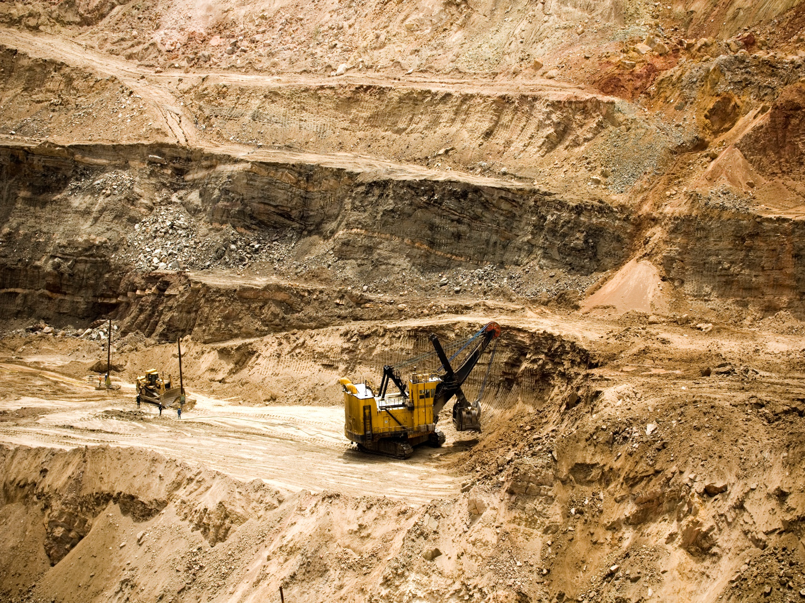





Presentation Outline
Location of Zambia
Economy at a Glance
Priority Sectors and Investment Opportunities
ZDA: Your Gateway to Zambia
Why Invest in Zambia

Slide 3

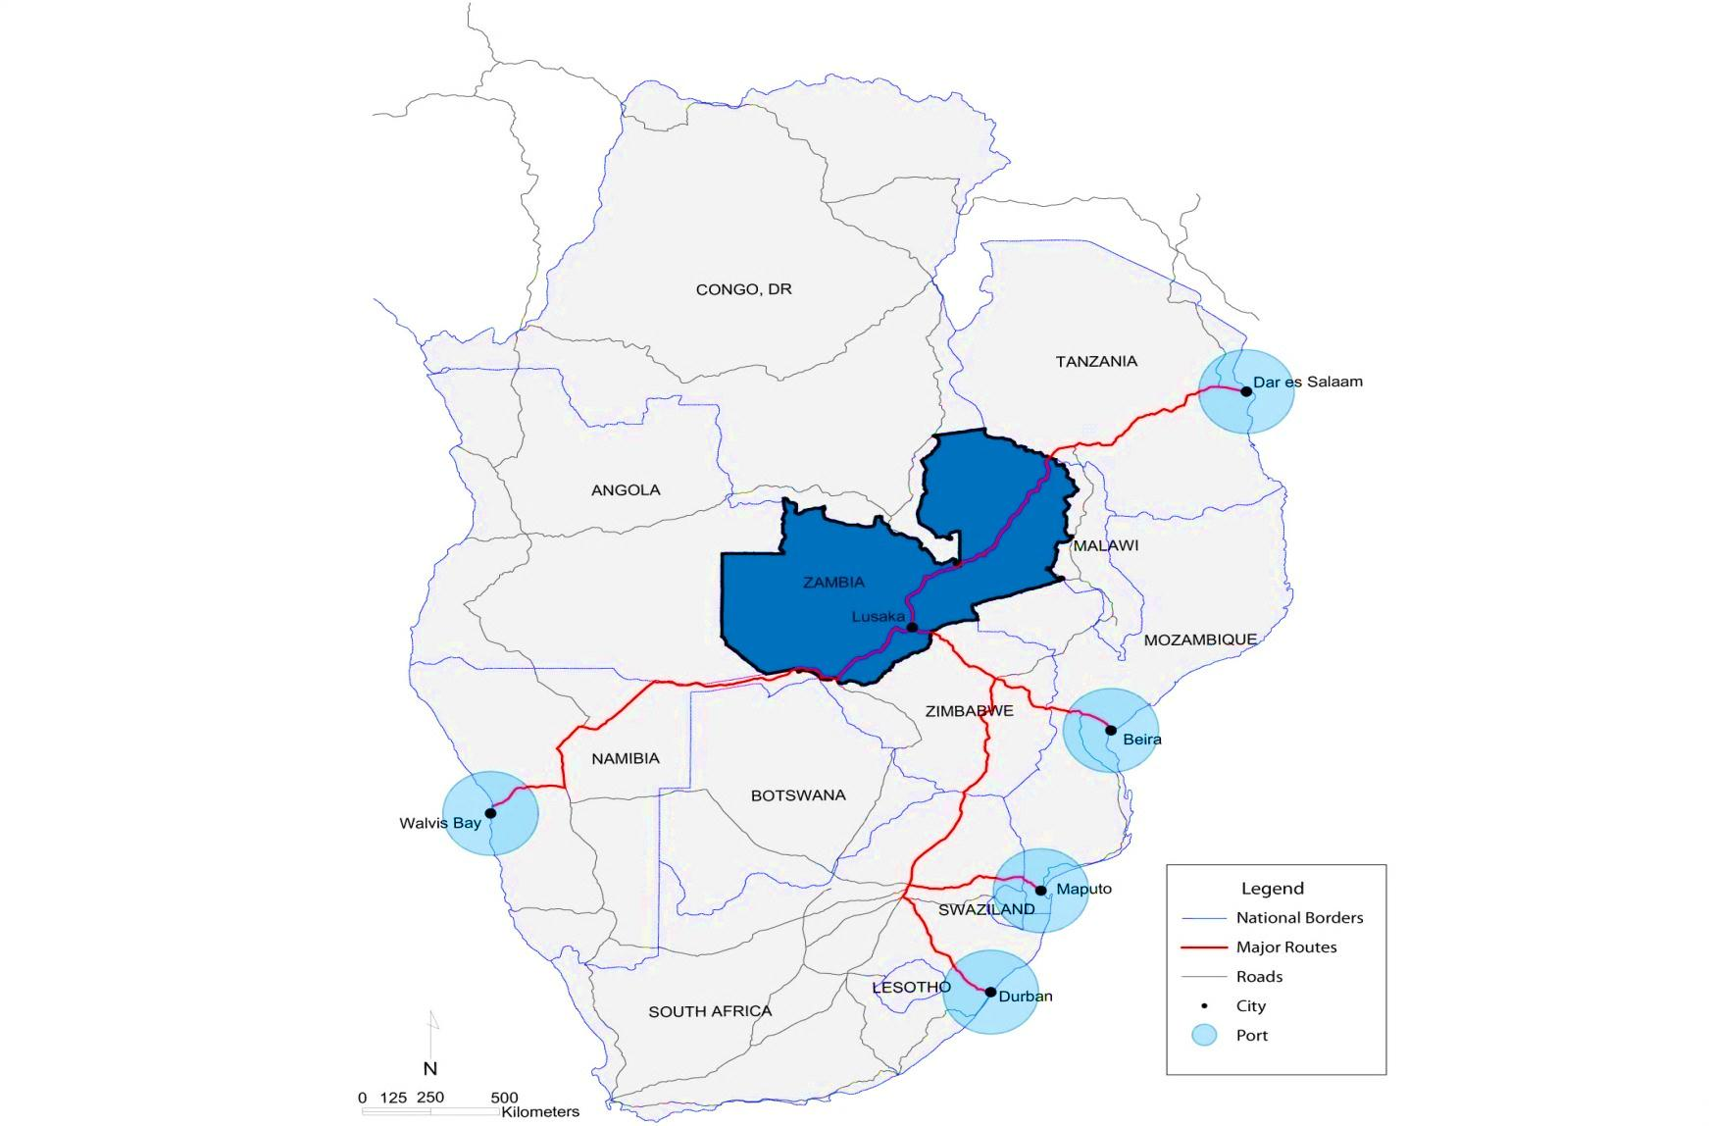
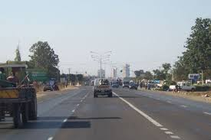


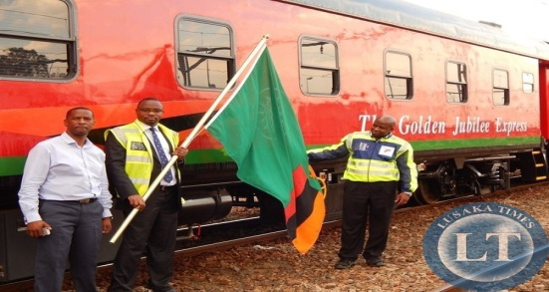
Strategically Located – Land Linked
By Road
Nairobi – 2hrs 45mins
Harare – 45mins
By Air
Johannesburg –2hrs
Addis Ababa – 4hrs
Dar-es-Salaam –2hrs
Dubai – 6hrs 30mins
By Rail
– 5 hrs

Slide 4
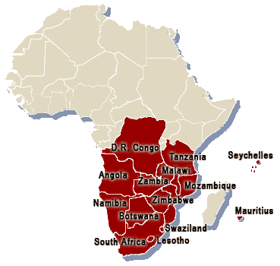
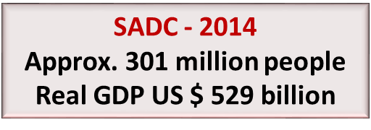

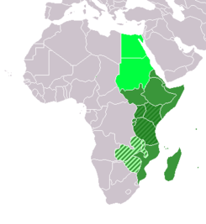
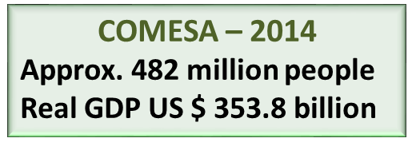
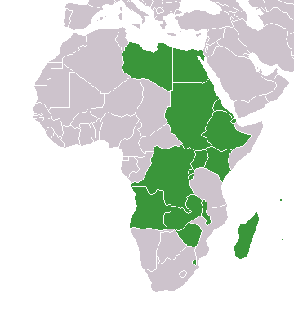
Gateway to Three Regional Markets: SADC, COMESA & EAC
Untapped growing regional market
Other Market Opportunities include;
EU through EBA
USA through AGOA initiative
Canadian, Chinese & Japanese Market Access Initiatives
EAC – 2013
Approx. 153.12 Million
GDP $108.98 Billion
Zambia become the 17th country to sign the COMESA-EAC-SADC Tripartite Free Trade Area Agreement (TFTA) on 17 June 2016 in Lusaka, Zambia.
TFTA is an integrated market of 26 countries with a combined population of 632 million people which is 57% of Africa’s population.

Slide 5

Economy at a Glance

Slide 6
Economy By Numbers
Area: 752,614km² (39th)
Population: 15.8 million (2016)
ECONOMIC STATISTICS
GDP : $ 19.92 billion (2016*)
Per Capita: $1, 260 (2016*)
GDP Growth Rate 3% (2016)
Foreign Exchange Reserves
  $2.4 Billion (Dec.2016)
Credit Rating (2015)
Moody’s B3
Fitch B
S&P B
Inflation (CPI): 7.5% (Dec 2016)
*Year end projections

Slide 7
Business Environment Reforms
The peaceful and democratic country of Zambia has for many years enjoyed both social and political stability as well as a healthy macroeconomic environment, with economic growth averaging around 6 percent per annum since 2003.
Zambia’s notable rankings in 2016 as a result of Business reforms improvements are:
Ease of Doing Business - World Bank
Zambia is ranked 5th in COMESA
2. Global Competitiveness Index – World Economical Forum
Zambia is ranked the 11th most competitive country in Africa
Doing business - Forbe's annual ranking
Zambia is ranked 9th by Forbes as the best country among 54 African Countries to do business.

Slide 8
GDP GROWTH RATES 2005-2016
The World Bank’s forecast on Zambia’s Gross Domestic Product in 2017 is at 4 percent and 4.2 percent in 2018.

Slide 9
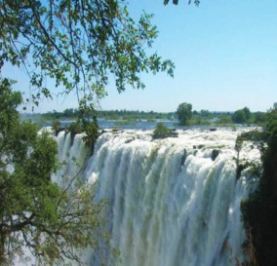
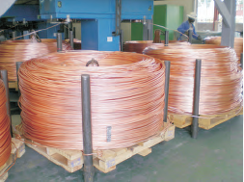
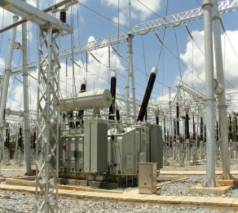
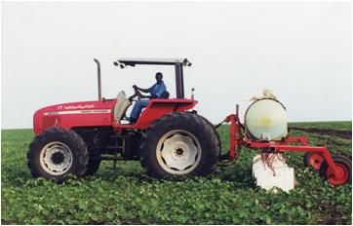
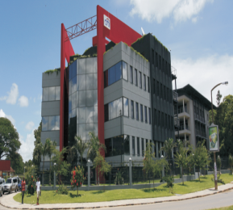
Priority Sectors and Investment Opportunities
Tourism
Manufacturing
Energy
Agriculture
Priority Sectors
Infrastructure Development
Notes:
Comprehensive solution, features

Slide 10


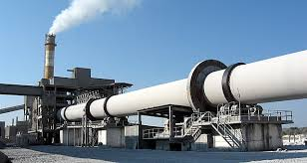
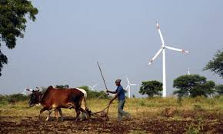
Investment Opportunities in Energy
The Government of Zambia has developed the Power System Development Master Plan whose objective is to provide a blue print for Power System Development up to the year 2030. Energy sources include: hydro, petroleum, coal, biomass, and renewable energy.
Power production potential: 6000MW, currently generating 2000MW.
Demand for petroleum exceeds 52 million litres per month and is growing at an average of 40% per annum.
Zambia has over 3,000 sunshine hours annually, average wind speeds of 2.5m/s above 10 meters, over 80 hot springs and ample rivers flowing through the country.

Slide 11
Investment Opportunities in Energy
Government is also encouraging investors to develop alternative energy sources and related energy mix including;
Solar Energy
Geo-thermal Energy
Bio-mass Energy
Ethanol
Bagasse
Waste to Energy (Cities)
Nuclear Energy

Slide 12
Investment Opportunities in Energy support infrastructure
The energy projects require infrastructure to supply users and this presents an opportunity for investing in Energy support infrastructure such as;
Manufacture of transmission lines for connection to the national grid
Manufacture of solar panels
Manufacture of transformers
Manufacture of spare parts for transformers and other parts
Maintenance and electrical faulty service provision

Slide 13

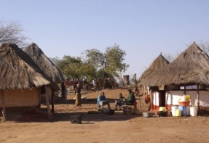
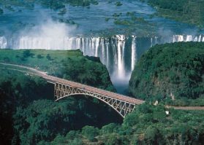

Investment Opportunities in Tourism
Zambia’s Potential
  Endowed with a vast variety of wildlife species
  19 national parks and game reserves
  Spectacular sites such as Victoria Falls, one of the seven natural wonders of the world and a UNESCO world heritage site.
  Rich cultural heritage
  Home to Africa’s 2nd largest park – Kafue National Park (22,480km² and fifth largest in the world

Slide 14

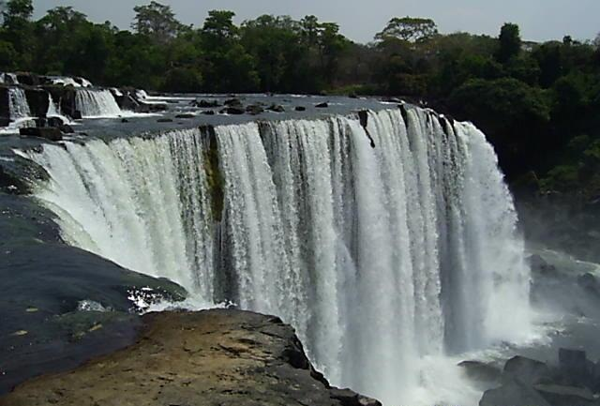
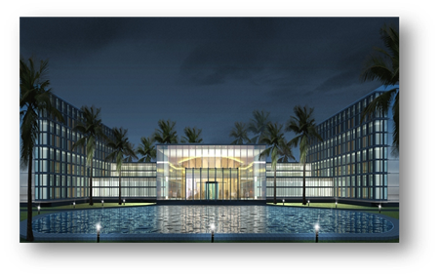
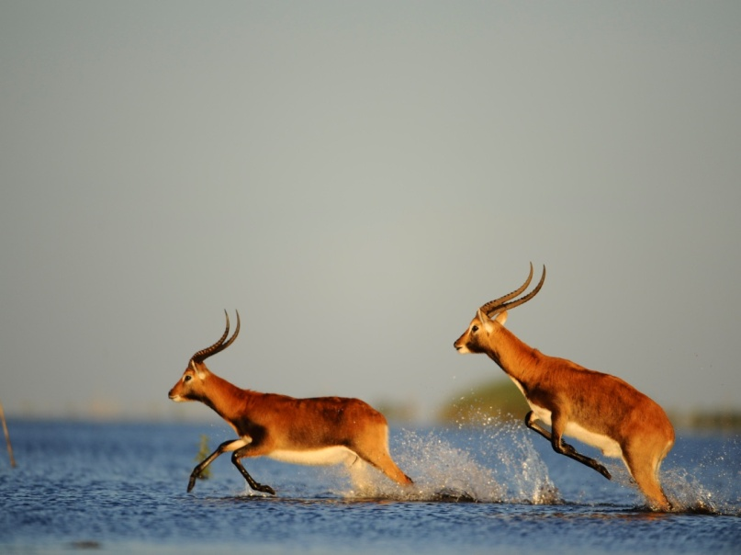

  Northern Circuit (Kasaba Bay)
Strategically located on the shores of Lake Tanganyika relative to the developed northern circuit of East African Region that includes Ngorongoro Craters, Serengeti National Park, Kilimanjaro Mountain and the Great Lakes Region giving opportunities for intra-regional tourism.
Central and Lusaka Province
Redevelopment of the existing Mulungushi International Conference Centre in Lusaka into an Ultra-modern International Conferencing facility.
Development of flagship lodges on the shores of Lake Itezhi-Tezhi, located in Zambia’ largest National Park that boasts around 22,000 square kilometres.
4 - 5 Star Hotel development

Slide 15


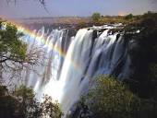


    Opportunities in The Tourist Capital Livingstone
    The area, includes Kafue National Park
    The area is earmarked for among others, Hotel and Lodge developments ranging from 50 to 400 bed capacity, Conference centers with at least 5,000 seating capacity and Shopping Arcades

Slide 16
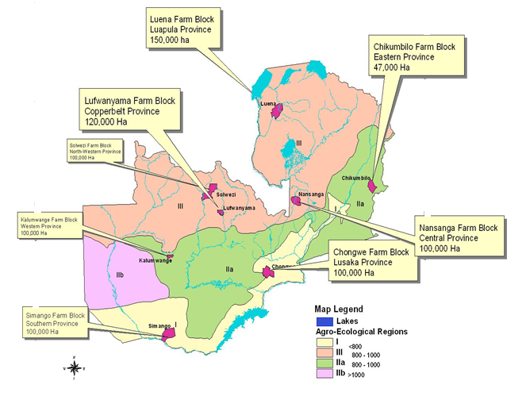
Investment Opportunities in Agriculture
  FARM BLOCK DEVELOPMENT
  Government has set aside 100, 000 Hectares in each of the ten provinces in Zambia for commercial agriculture coupled with small holder farmer integration.
 | Farm block | Size (Ha)
1 | Nasanga | 155,000
2 | Kalumwange | 100,000
3 | Luena | 100,000
4 | Manshya | 147,000
5 | Mikelenge/ luma | 100,000
6 | Musakashi (SADA) | 100,000
7 | Mungu | 100,000
8 | Simango | 100,000
9 | Mwase-phangwe | 100,000

Slide 17

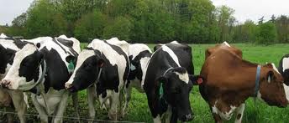

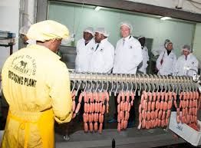
Investment Opportunities in Agro-processing
Vast investment potential for food processing in the country exist, covering both large and small scale industries in each of the 10 Provinces.
Agro-processing and value addition opportunities exist in the following areas:
  Eastern Province – Maize, Cotton, Beans, Tobacco and Groundnuts processing
  Luapula Province - Aquaculture, Cassava and Maize processing
  Southern Province - Beef, Dairy and Meat Processing
  North Western Province – Pineapple canning, Honey production, Agro forestry, Coffee,
  Muchinga Province – Rice and maize (Cereals and mill) processing
  Western Province – Tobacco, Rice and Cashew Nuts processing
  Central Province – Wheat, Soya, Sunflower and Maize

Slide 18
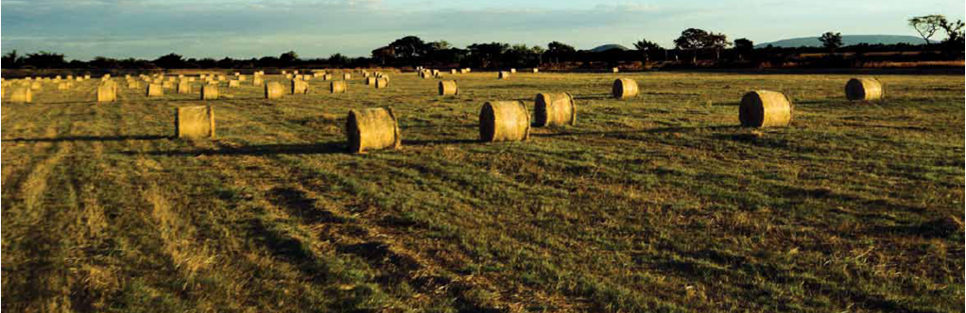
Three Agro Ecological Regions (Rainfall, Soil and Crop Suitability)
Region III:
< 1,000mm of rainfall/ annum
Very deep soils, sandy clay loam.
Cassava, millet, sorghum, beans, groundnuts, rice, coffee, tea, pineapples, fish farming, livestock.
Region I:
>Rainfall range 800mm/annum
Loamy to clay soils
Cotton, sorghum millet, seseme, cashew nuts, livestock, fisheries
Region II:
Rainfall range - 800 to 1,000mm/annum
Inherent fertile plateau soils.
Maize, cotton, tobacco, sunflower, soybeans, irrigated wheat, groundnuts, flowers, paprika, vegetables, cassava, millet, horticulture, livestock.

Slide 19



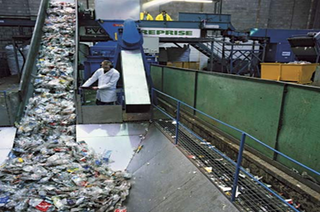
Investment Opportunities in Manufacturing
Zambia’s manufacturing sector has considerable investment potential as the domestic economy is relatively well endowed with resource factors such as; raw materials, skilled labor force, abundant land, water and rich minerals.
Opportunities exist in the manufacture of the following;
Textile and Clothing manufacture
Mineral processing (value addition to copper and gemstones)
Chemical products
Leather products
Pharmaceutical products
Manufacture of computer tablets

Slide 20
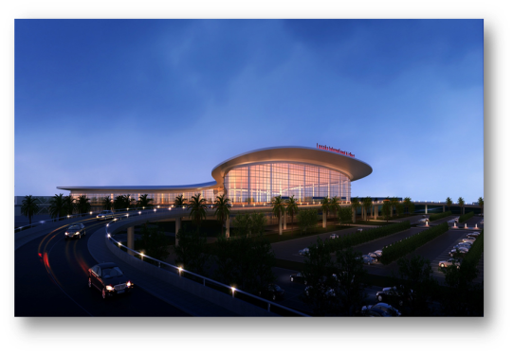
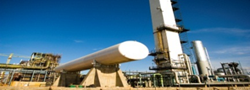


Investment Opportunities in Infrastructure Development
Infrastructure development is one of Government’s priority areas, and is upheld in both the National Development Plan and Vision 2030. These are mainly PPP Projects and opportunities exist for infrastructure development in the following areas;
  Road infrastructure – Government is accelerating National roads construction through programme “Link Zambia 8000” among others.
  Railway infrastructure
  Energy infrastructure
  Convention, hotel and Exhibition Infrastructure
  Airport infrastructure

Slide 21
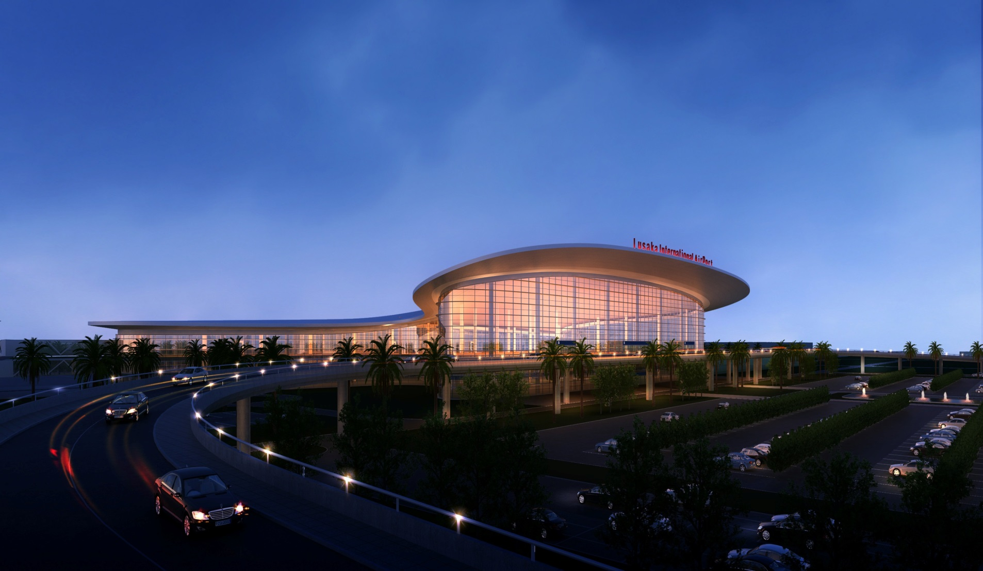
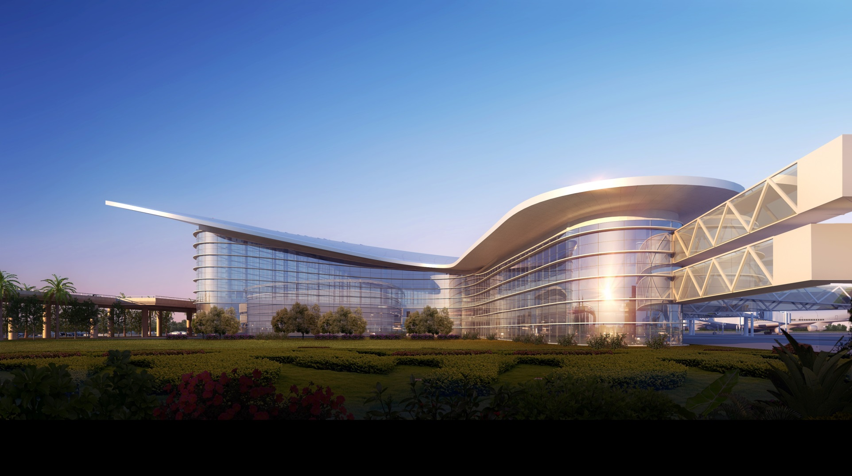
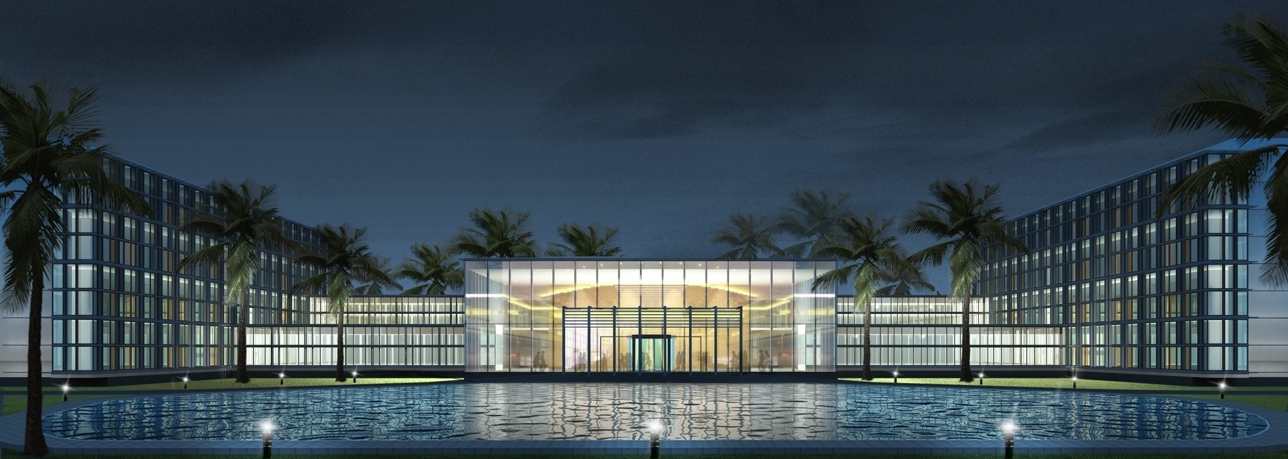
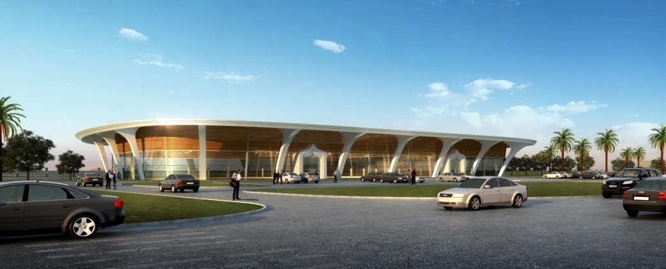
Kenneth Kaunda International Airport
On-going Infrastructure Development Project
Passenger Terminal (Night View)
Passenger Terminal (Western View)
80 Room Airport Hotel
Standalone VVIP Facility

Slide 22

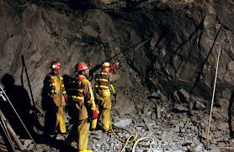
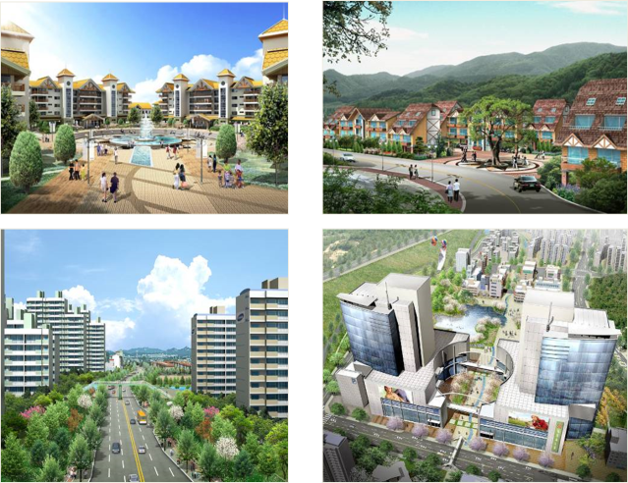
Other Productive Sectors and Investment Opportunities
Information Communication
Technology
Mining
Real Estate
Other Productive sectors
Notes:
Comprehensive solution, features

Slide 23

Investment Opportunities in Mining and ICT
Zambia is the 2nd largest producer of copper in Africa and produces 20% of the world’s output of high-grade emeralds.
The country still has large deposits of
gold
silver
gemstones and industrial stones
which remain underexplored thereby presenting enormous opportunities for investment.
Mining
Demand for ICT services in Zambia is growing rapidly. The Internet Service Providers (ISPs) sub-sector is among the most competitive in the ICT industry in Zambia.
Other investment opportunities in the ICT sector include:
Manufacture of ICT Devices and Equipment such as tablets and laptops
Business Processing Outsourcing for services such as call center management and infrastructure maintenance
Software Application Development
Date Management and Storage Services

Slide 24
Investment Opportunities in Real Estate
Zambia’s residential market is growing with its emerging middle class; however housing deficit stands at 1.5 million per annum. Commercial and industrial real estate presents significant opportunities for investment.
Investment opportunities exist in the real estate sector for:
Development of high-quality office buildings.
Development of Industrial and warehousing facilities.
Development of low, medium and high cost houses through private to private partnership and public private partnership.
Development of commercial real estate such as shopping malls.
Real Estate

Slide 25
SECTOR SPECIFIC PROJECTS
THE ZDA PROJECTS BOOKLET
Project Title | Project Summary | Estimated Investment (US$) | Contracting Authority and/ or Promoter | Project Requirements/ Financing Mode

Slide 26

Investment Incentives
1
Tax Incentives
Corporate Income Tax : 0% for 5 years
Zero percent tax rate on dividends for 5 years
No Import Duty on equipment and machinery for five years
2
Non-Tax Incentives
Investment guarantees and protection
Free facilitation for application of permits, licenses, land acquisition and utilities
3
Location Support
Multi Facility Economic Zones
Industrial Parks
Rural Area

Slide 27
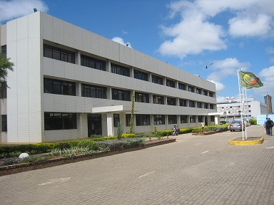
ZDA: Your Gateway to the Zambian Economy

Slide 28



Services offered by ZDA
Assist in
Land acquisition for investment
Provide information
on markets
and industries
Assist in seeking
business partners
Comprehensive support
to foreign & local investors
Provide immigration
&
administrative
support services
Advise on
Investment incentives
Arrange meetings
with government ministries

Slide 29



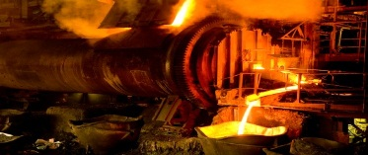
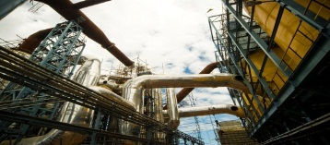
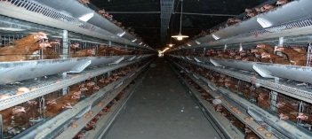
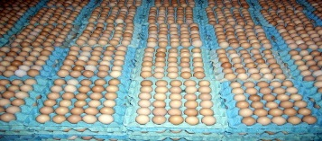
SUMMARY
Reasons to Invest in Zambia
Political stability, peace and democracy
Adherency to rule of Law, positive and investor friendly environment
Investment guarantees and Security
Abundant natural resources presenting excellent investment and trade opportunities
Private Sector driven Government Economic Development Policy in place
Attractive Investment Incentives
No exchange controls and repatriation of 100% of profits since 1994
Duty free access to regional, wider Africa, EU and USA Market.
Progressive Banking legal and Insurance Services of International standards
Good place to work and live, friendly people with rich culture.

Slide 30






























Successful Investors in Zambia

Slide 31


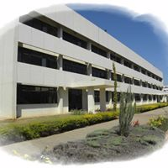

THANK YOU!
Contact us for further Information:
The Director General
Zambia Development Agency
Privatisation House, Nasser RD
P.O. Box 30819,
LUSAKA, ZAMBIA.
Tel: +260 211 220177
Fax: +260 211 225270
Website: www.zda.org.zm
Email: info@zda.org.zm
Export Development
Investment facilitation

